Slide 1
John Freeman Lewes February 2015
-the Juicy Bits

Slide 2
Q: King John has been described as “ an awful king”,
“ a tyrannous whelp”,
“ foul as it is, Hell itself is defouled by the foulness of John”

Slide 3
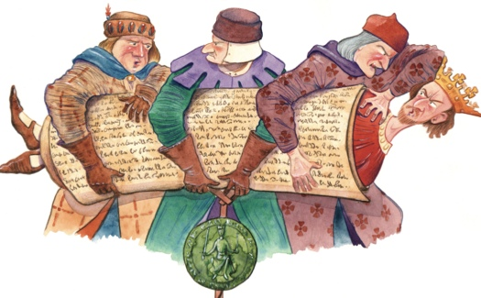
Q:Who said this?
The Wife
Sellar and Yeatman
Ralph de Coggeshall
Giraldus Cambrenisis
Matthew Paris

Slide 4
Answers: 2.- Sellar and Yeatman (1066 and all that)
4.-Gerald of Wales (1146-1223) Archdeacon of Brecon and Cirencester
5.-Matthew Paris (1200-1259) Chronicler and monk of St. Albans Abbey
Ralph de Coggeshall ( died 1227) Abbot of Cistercian monastery at Coggeshall, actually said “ evil customs which the father (Henry11) and brother ( Richard ) of the king had created along with the abuses John added”

Slide 5
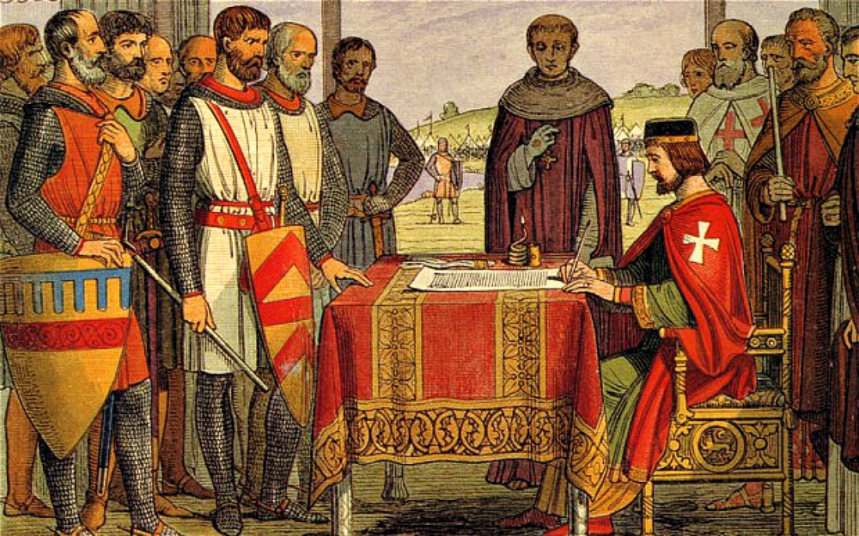
Q:What’s wrong with this picture?
He signed it with his left hand
He used a ballpoint pen
He didn’t sign it!
It is a picture of the wrong king

Slide 6
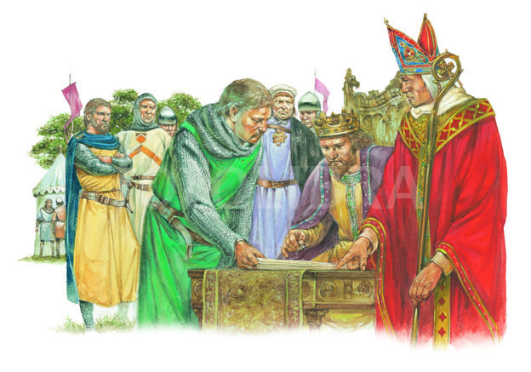
Answer: 3.-The Magna Carta was never signed ! Copies were sealed with King John’s Great Seal –but after Runnymede
John could read but it is not known if he could write

Slide 7
King John’s Great Seal

Slide 8
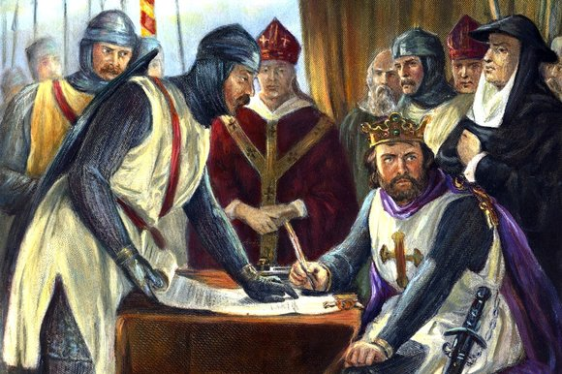
Q: What was Magna Carta written on?
Parchment
Vellum
Basildon Bond
Fine paper

Slide 9
Answer: Parchment- like all medieval charters.
Manufactured from sheepskin which was soaked in a bath of lime, stretched on a frame to dry under tension and scraped with a crescent shaped knife called an Innuler to produce a smooth writing surface.
A quill ( long feather) was used to write with
Ink was produced by mixing iron salts with a caustic liquid extracted from galls in oak trees
It was written in heavily abbreviated Latin

Slide 10
Magna Carta

Slide 11
Runnymede
Q: Why was the Magna Carta negotiated at Runnymede?

Slide 12
It was convenient to the M 25
King John owned the land
Convenient meeting place for King John and the Barons
It was unsuitable for any fighting to take place

Slide 13
Answers: 3.-King John was at Windsor (went home each night) and the Barons were at Staines 4.- The land was boggy and deliberately chosen by the Barons

Slide 14
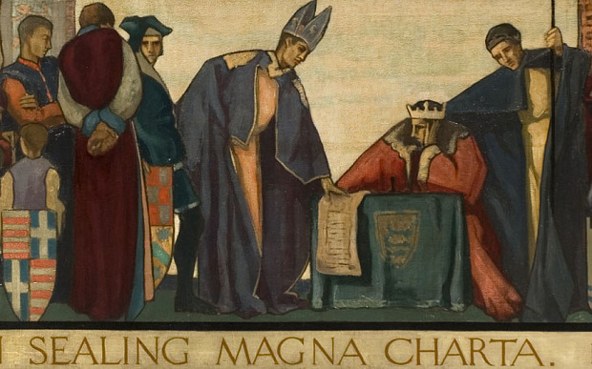
Q: King John agreed to Magna Carta because
He could see no alternative
He believed in democracy
He believed the Pope would annul it
He believed the Barons would not have the will to implement it

Slide 15
A: 1 -No King had allowed the power of the King to be limited by a written document. He had to do it because the Barons had a power base including London.
3 -He believed the Pope would never agree to such restrictions on his authority.
John wrote to the Pope ( Innocent111) in July seeking annulment and the Pope issued a Papal Bull (a legal document) declaring it null and void-dated 24th August 1215 but arrived in England at the end of September. Therefore Magna Carta legally lasted only 10 weeks.

Slide 16
Q: Which member of Lewes Castle Rotary is mentioned in Clause 39?
The Secretary ( representing Scotsmen)
The President ( representing Scholars)
Past President ( representing Northerners)
President Elect ( representing humble people)

Slide 17
Answer: Clause 39
4.-No free man shall be seized or imprisoned, or stripped of his rights or possessions, or outlawed or exciled, or deprived of his standing in any other way, nor will we proceed with force against him, or send others to do so, except by lawful judgement of his equals or by the law of the land.

Slide 18
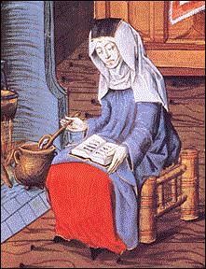
Q: How many times does the word “woman” appear in the words of the Magna Carta?
Loads
Not at all
Once
Twice

Slide 19
Answer: 3.-Clause 54
3- No one shall be arrested or imprisoned on the appeal of a woman for the death of any person except her husband.
The roles of “the wife” are referred to in Clauses 7,8,11,15

Slide 20
Q: Which clauses were added to gain the support of the Merchants of London?
Removal of all fish weirs on the Thames
Allowed to sell their wares on Sunday
Standardisation of weights and measures
Free entry to Stamford Bridge on Saturdays

Slide 21
Answers: 1-Clause 33 3-Clause 35

Slide 22
Q: Which clause caused King John the most grief?
Clause 27-If a free man dies intestate his moveable goods go to his wife not the Crown.
Clause 33-All fish weirs shall be moved from
the Thames and the Medway.
Clause 40- To no one will we sell, to no one
deny or delay right or justice.
Clause 61-The Barons shall elect 25 of their
number to keep the peace and liberties granted
and confirmed by this charter.

Slide 23
Answer: 4 -This is called the “Security Clause” and allowed 25 Selected Barons to ensure the King carried out Magna Carta. Penalty-loss of taxation and his Property

Slide 24
Q: 4 examples of the 1215 Magna Carta still exist but where is the master copy housed?
Lincoln Castle
Salisbury Cathedral
Canterbury Cathedral
The Houses of Parliament
The British Library

Slide 25
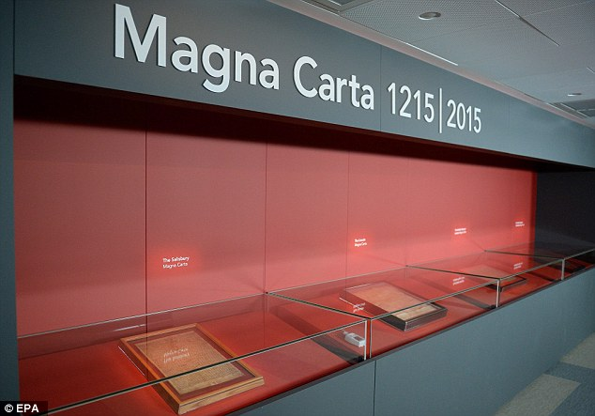
Answer: Nowhere! There never was a “master” copy. !3 equal copies were produced.
2 are at the British Library, 1 at Salisbury Cathedral and 1 at Lincoln.

Slide 26
So Freemen rule OK!

Slide 27
John Freeman Lewes February 2015
-the Juicy Bits

