Slide 1
www.magnacarta800th.com
Magna Carta 800th Briefing
February 2015

Slide 2
Outline of the Presentation
1. Magna Carta: Background & Objectives
2. Why Commemorate the Magna Carta?
3. Magna Carta 2015 Commemoration Governance
4. Key Achievements to Date
5. Highlight Events 2015
6. Plans and Priorities for 2015
7. UK Government Support Requests
8. 15 June 2015 at Runnymede
9. Merchandise

Slide 3
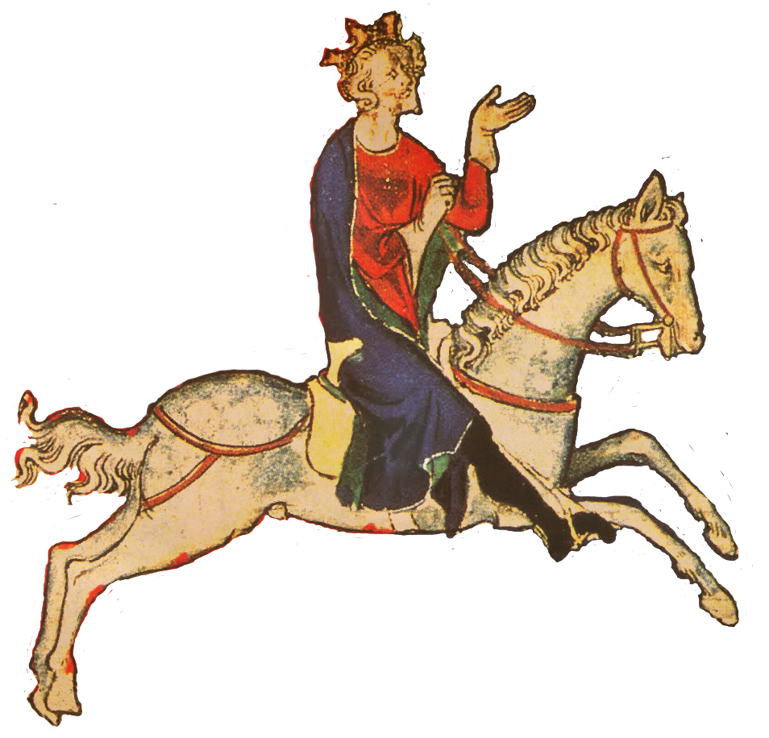
Magna Carta - Background
The original Great Charter was agreed by King John, 15 June 1215, when he acceded to barons’ and bishops’ demands to limit his powers, first sealed on 19 June 1215 and distributed throughout the land.
The 1215 version of Magna Carta was revised several times in the 13th Century, reissued in 1216 after the death of King John, revised in 1217 and 1225.
The 1297 version was brought into English law, virtually unchanged from the 1225 version.
There are 4 known surviving copies of the 1215 Magna Carta - at Lincoln (1) and Salisbury (1) Cathedrals and in London at the British Library (2).
There are 13 known surviving later XIII C. copies – Durham (1216) (1225), Hereford (1217), Oxford (1217x3) (1225), London (1225x2) (1297x2), Canberra, Australia (1297), Washington, DC, USA (1297).
And another 6 (or 7?) of the 1300 Magna Cartas in the City of London, Durham Cathedral, Faversham Town Council, Oxford (2), and Westminster Abbey (and Society of Antiquaries in London as well). Making 24 in all we know of.

Slide 4
Commemoration Objectives
The Objectives of the Magna Carta Trust were defined in its 1957 Charter as:
the perpetuation of the principles of Magna Carta
the preservation for reverent public use of sites associated with Magna Carta
the commemoration triennially and on such other special occasions as shall be determined by the Trust, of the grant of Magna Carta, as the course of the constitutional liberties of all English-speaking peoples, and a common bond of peace between them
The Trust’s Statement of Objectives for the 800th Anniversary, agreed by unanimous vote of Trustees at its 5 October 2009 meeting:
To co-ordinate the 800th Centenary Celebrations of the sealing of the Magna Carta
To co-ordinate the upgrading of the Magna Carta Memorial on the Runnymede site
To ensure that all appropriate interests as determined by the Trustees are able to input ideas and suggestions into the Steering Group’s deliberations
To ensure that Trustees can provide a strategic lead in determining the nature and scope of the celebrations on a national and international basis
To determine costing and potential sources of funding
To develop a communications strategy to inform the media and all other interests of the Trust’s initiatives
To consider what the legacy of the 2015 celebrations shall be
To report regularly to the Trustees on progress
To coordinate the plans and activities of the local committees (added at the following Trust meeting)

Slide 5
Magna Carta Matters:
‘England’s greatest export’:
Foundation stone of the liberties enjoyed by hundreds of millions of people in more than 100 countries
It has influenced constitutional thinking worldwide in over 100 countries; as well as the UN Declaration of Human Rights
‘Due process’:
Enshrined the rule of law in English society
Denials of Magna Carta’s basic principles have led to a loss of liberties and human rights and even genocide in many countries for centuries
‘No one is above the law’:
Limited the power of authoritarian rule
‘Justice delayed is justice denied’:
Paved the way for trial by jury
The 800th anniversary of Magna Carta is an occasion to deepen the understanding of the crucial role it has played in our development
‘No taxation without representation’:
Linked taxation to democratic government, the theme of the American revolution
It is a time to commemorate the individual rights we enjoy today. It is an opportunity to strengthen human rights around the world
“The English Church shall be free’:
Proclaimed core religious liberties

Slide 6
2015 Commemoration Committee
Magna Carta Trust Members: Rt Hon the Lord (John) Dyson (Chair, Magna Carta Trust); Sir Robert Worcester KBE DL (Deputy Chairman, Magna Carta Trust; Chair, Magna Carta 2015 800th Anniversary Committee); Very Rev Philip Buckler (Dean, Lincoln); Colin Carmichael (CEO, Canterbury City Council); Mrs Margaret Charlesworth (St Edmundsbury); Ron Freeman (Pilgrims Society); Rt Hon the Lord (David) Howell of Guildford (Commonwealth Society); Robert Kahn (Law Society); Dame Mary Richardson DBE (Chairman, English-Speaking Union); Lewis L Neilson (Chancellor, National Society Magna Charta Dames and Barons); Stephen Zack (Chairman, ABA Magna Carta 2015 800th Anniversary Committee; Past President, ABA).
Co-opted Committee Members: Danielle Alexandra; Frank Baldwin (Battlefields Trust); Tony Badger; Julia Bateman (Global Law Summit); Joe Beckett (HCL); Professor Robert Blackburn (Kings College London); James Blake (St Albans); Desmond Browne QC (Bar Council); Andrew Caplen (Law Society); Laura Caton (Local Government Association); former MCT Hon Treasurer Stuart Cawthorne; Cllr Helyn Clack (Surrey); Liz Clarke (Temple Church); Martin Clutterbuck (UK Metric Association); John Collier (Salisbury); Cllr Derek Cotty (Runnymede); Edward Dawson (Battlefields Trust); Hugh Doherty (Oxford); Leslie Dubow (English-Speaking Union); Nic Durston (National Trust); Seif El Rashidi (Salisbury); Leanne Fallin (US Embassy); Peter Farr (Rt Hon the Lord Dyson’s Office); Laurence Fiddler (Ministry of Justice); Professor Justin Fisher (Brunel); Nick Fluck (Law Society); Corinne Galloway (Houses of Parliament); Mark Gill (Executive Director); John Gillespie (British Council); Peter Gold (Local Government Association); Jeffrey Golden (ABA); Leslie Good (St Albans); Daniel Goodwin; Rt Hon Dominic Grieve QC MP; The Rev Robin Griffith-Jones (Temple Church); Dr Elizabeth Hallam-Smith (House of Lords); Tony Halmos (City of London); Simon Higman (RHUL); Simon Hughes MP (MoJ); Jacqui Ibbotson (Oxford); Keith Johnston; Dr Emm Johnstone (RHUL); Jo Jones (Canterbury); Dr. Robert Key (Salisbury); Alex King (Kent) (Treasurer); Eleanor Laing MP; Barbara Lewis (University of the Third Age); Caterina Loriggio (Houses of Parliament); Charles C. Lucas, Jr (Baronial Order of Magna Charta); Sir Nicholas Macpherson KCB (HM Treasury); Dan Magraw (ABA); Gerard McDermott (ABA); Sophie McIvor (British Library); Michael McKay (HCL); Scott McKendrick (British Library); Rt Hon the Lord (Tom) McNally; Councillor Hugh Meares (Runnymede); David Michnal (Baronial Order of Magna Charta); Caroline Miller (US Embassy); Peter Milton (Surrey County Council); Glyn Morgan (Hereford); Olivia Nelson (National Trust); Anthony Northey (Notaries Society); Susan Osborn (Notaries Society); Richard Ovenden (Oxford); Alice Pearson (Inner Temple); Dr Dan Plesch (Our Democratic Heritage); Rev Canon Christopher Pullin (Hereford); John Pullinger (House of Commons); Alice Richmond (ABA MC Committee); Geoff Rivers (St Edmundsbury); Steve Roberts (English-Speaking Union); Jane Robinson (Durham); Len and Suzy Rodness (Magna Carta Canada); David Ruffley MP; Professor Nigel Saul (Royal Holloway, University of London); Lucy Scott-Montcrieff (Law Society); Paul Seaward (History of Parliament); Adrian Sharpe (Sharpe Lankester); Geri Silverstone (National Trust); David Sleight (Lincoln); Sarah Smith (Law Society); Greg Spring (Coins & Stamps Sub-Committee); Cllr Paul Tuley (Runnymede); MCT Hon Sec Paul Turrell (Runnymede); Bob Vivian (Baronial Order of Magna Charta); Sarah Walsh (Runnymede); Harvey Watson (Battlefields Trust); Scott Wilson (Magna Carta 800th Commemoration); Nick Wood-Dow (Chelgate).

Slide 7
2015 Advisory Board
Members of the 800th Advisory Board: Former Heritage Lottery Fund Dame Jenny Abramsky; Graham Allen MP; Rt Hon Lady Justice Arden DBE; Former Lord Mayor of London Michael Bear; Speaker, House of Commons Rt Hon John Bercow MP; Former Home Secretary Rt Hon David Blunkett MP; Former Chief of Defence Staff, Lord Warden and Admiral of the Cinque Ports, President, Pilgrims Society, Admiral Lord (Michael) Boyce GCB OBE DL; US Supreme Court Justice Professor Stephen Breyer; Former Chief Executive British Library Dame Lynne Brindley DBE; Chairman Law Society Andrew Caplen; Chief Executive Officer, HCL AXON , HCL Technologies, Steven Cardell; Former Foreign Secretary Rt Hon Lord (Peter) Carrington KG CH GCMG MC; Rt Rev Lord Bishop of London Richard Chartres; Lord Chancellor Rt Hon Kenneth Clarke QC MP; Supreme Court Justice of the United Kingdom Rt Hon Lord (Tony) Clarke; Chairman, History of Parliament Trust Lord (Patrick) Cormack; Lord Speaker Baroness (Frances) D’Souza; Former Shadow Home Secretary Rt Hon David Davis MP; British Council Chairman Sir Vernon Ellis; Chairman of Magna Carta Committee of Australia Air Chief Marshal David Evans; Former Lord Chancellor Rt Hon Lord (Charlie) Falconer QC; Former Chair of the Arts Council England Dame Liz Forgan DBE; Private Secretary to HM Rt Hon Sir Christopher Geidt KCVO; Dr Hamid Ghany, University of West Indies; National Trust Director-General Dame Helen Ghosh; Former UK Attorney-General Rt Hon Dominic Grieve QC MP; Loyd Grossman (Heritage Alliance); Foreign Secretary Rt Hon Philip Hammond MP; Former Lord Speaker Rt Hon Baroness (Helene) Hayman; Former Leader of the House of Lords Rt Hon Lord (Jonathan) Hill of Oareford CBE; University of Virginia Professor A E Dick Howard; ABA President William Hubbard; Former Chairman English-Speaking Union Rt Hon Lord (David) Hunt of Wirral; Former Lord Chancellor Rt Hon Lord (Alexander) Irvine of Lairg; Former Private Secretary to HM The Queen Rt Hon Lord (Robin) Janvrin; Chairman of the National Trust Sir Simon Jenkins; Former Home Secretary Rt Hon Alan Johnson MP; Rt Hon Dame Tessa Jowell DBE MP; Lady (Barbara) Judge CBE; Former Lord Chief Justice Rt Hon the Lord (Igor) Judge; Sheriff for the City of London Alderman Sir Paul Judge; US Senator Tim Kaine; Chairman Bar Council Nicholas Lavender QC; Former Lord Chancellor Rt Hon Lord (James) Mackay of Clashfern; Former Chairman Royal Commonwealth Society Sir Peter Marshall; Permanent Secretary HM Treasury Sir Nicholas Macpherson KCB; Former Prime Minister of Trinidad and Tobago, Former Chair of the Commonwealth Hon Patrick Manning; Former Deputy Secretary Commonwealth Secretariat Mmasekgoa Masire-Mwamba; Home Secretary Rt Hon Teresa May MP; Former First Secretary of Wales Rhodri Morgan; Former Director of the National Archives Oliver Morley; His Eminence Cardinal (Vincent) Nichols; Prime Minister of Trinidad and Tobago, Former Chair of the Commonwealth Hon Mrs Kamla Persad-Bissessar; Former Chairman Equal Opportunity Commission Trevor Philips; UK Supreme Court Justice Rt Hon Lord (Nicholas) Phillips of Worth Matravers; Rt Hon Baroness (Usha) Prashar of Runnymede; Former Home Secretary Rt Hon the Lord Reid of Cardowan; Len and Suzy Rodness, Magna Carta Canada; Former Chairman English-Speaking Union Dame Mary Richardson DBE; Sir John Ritblat; Secretary-General International Bar Association Mr David W Rivkin; Mrs Franklin D Roosevelt Jr; Chairman of Carlyle Group and Magna Carta private owner David Rubenstein; Former Chief Rabbi Lord Sacks, Chairman of the Charity Commission William Shawcross, Former Secretary of State for Culture, Media and Sport, now Chairman Environment Agency Rt Hon Lord (Chris) Smith of Finsbury, Former Lord Chancellor, Minister for Justice and Home Secretary, Rt Hon Jack Straw MP; Hungarian Ambassador to the UK Peter Szabadhegy; Lord Chief Justice Rt Hon Lord Thomas of Cwmgiedd; Former Director-General of the BBC Mark Thompson; Professor of Medieval History, University of East Anglia Professor Nicholas Vincent; Former Chief Secretary to the Treasury, Cabinet Minister Lord (William) Waldegrave of North Hill PC; GovNet CEO Jo Walsh; Former International Chair, English-Speaking Union, Lord (Alan) Watson of Richmond CBE; Dean of Canterbury The Rt Rev Robert Willis, Lord Mayor Fiona Woolf; Former Chairman Magna Carta Trust Rt Hon Lord (Harry) Woolf; Former Lord Mayor Sir David Wootton; Marymount College Professor Kenton Worcester; Former Chief Executive of the Charity Commission Sam Younger and Former President of the American Bar Association and Chairman of ABA Magna Carta Committee Stephen Zack.

Slide 8
Letterman’s Questions
Q. Where was Magna Carta signed?
Nowhere – it was sealed
Q. Where was Magna Carta agreed?
Runnymede
Q. When was Magna Carta agreed?
A. 15 June 1215

Slide 9
85% of adults and 60% of young people have heard of the Magna Carta
Q) “I am going to read out a list of some historical documents. Which, if any, of these have you heard of before this interview?”
18-65+
18-24s
Total
US Declaration of Independence
87%
90%
UN Declaration of Human Rights
82%
89%
Domesday Book
73%
87%
Magna Carta
60%
85%
King James Bible
57%
70%
Lindisfarne gospels
15%
39%
Codex Sinaiticus
13%
Textus Roffensis
5%
None of these
2%
Base: 1,005 GB adults, 20-24 October 2012 Source: Ipsos MORI / Magna Carta 800th

Slide 10
A quarter of those who have heard of Magna Carta know about it in some detail
Q) “As far as you know…
...when was Magna Carta sealed?”
...where in England
was Magna Carta agreed?”
...which King agreed to Magna Carta?
Runnymede
King John
1215 / 1200s
Don’t know
Don’t know
Don’t know
Other answer/DK
Other answer/DK
Other answer/DK
10
Base: 887 GB adults who have heard of Magna Carta, 20-24.10.2012 Source: Ipsos MORI /Magna Carta 800TH

Slide 11
Six in ten who’ve heard of Magna Carta know it guaranteed Rule of Law
Q) “Which, if any, of these rights do you think the Magna Carta guaranteed?”
60%
The Rule of Law
Trial by jury
49%
Democracy
38%
Freedom of speech
36%
Basic human rights
35%
Freedom from arbitrary arrest
30%
Freedom of religion
25%
The right to vote
21%
Equal rights for women
9%
Nothing / none
2%
Don’t know
12%
Base: 887 GB adults who have heard of Magna Carta, 20-24 October 2012 Source: Ipsos MORI / Magna Carta 800th

Slide 12
Key Achievements To Date
HM The Queen as Patron of the Magna Carta Trust
St Albans 2013 Magna Carta weekend and Stakeholder meeting
Advisory Board, MC800th Committee and Sub Committees established
Bury St Edmunds 2014 Sound & Light show and Stakeholder meeting
£1 million grant announced by Chancellor
Launch of Junior Lawyers in Schools programme
Dedicated website established and social media activity ongoing
Magna Carta Book (Nicholas Vincent) ABA Edition launched
Launch of www.magnacartatrails.com
Telegraph as media partner; planning range of activities with the BBC TV and radio
Wide range of stakeholders engaged, co-ordinating activities and aspirations
“The Great Charter” play script written
At least five music compositions planned (Cantata completed; Calypso, Medieval Anthem, Pop/Rock, Hip Hop)
Royal Mail Magna Carta stamps agreed for launch in June 2015
Agreement on international conferences (UK, USA, Eastern Europe and Caribbean)
£2 commemorative coin agreed
Magna Carta Evensongs at Temple Church
Conducted baseline survey of the British public’s understanding of Magna Carta

Slide 13
133 DAYS TO G0! (from 1st Feb)
www.magnacarta800th.com

Slide 14
Highlight Events 2015
Magna Carta Guildhall Dinner: 12th January 2015
Runnymede Magna Carta Commemorations: 15th June 2015
Library of Congress Exhibition, 4 November 2014 – 19 January 2015, Symposium 9 December 2014
Events across Magna Carta Towns 2015
National and international conferences and symposiums UK, US, Eastern Europe, Caribbean, other countries
British Library Exhibition, largest ever held, 13 March -1 September 2015
First Day launch(es) and circulation of commemorative coins/stamps
UK Supreme Court Exhibition, 1 August – 30 September 2015
American Bar Association conferences, meetings and displays
UK Parliament Exhibition, National Archives
British Library, Salisbury and Lincoln 1215 Magna Carta on display, also Durham, London, National Archives, Oxford, etc.
Events at Temple Church and Inns of Court, January 2015
14

Slide 15
MC800th’s Priorities for 2015 (1)
Continue co-ordination mechanisms for partners, e.g. monthly meetings
Allocate remaining UK Government Grant
Continue stakeholder outreach: next networking event in Feb 2015
Provide a strategic lead for the national and international communications of the anniversary, especially across social media
Support key stakeholders hosting Magna Carta events in 2015
Continue to develop deeper ties with The Commonwealth, as directed by Her Majesty The Queen, and internationally generally
Promote MC800th website as core communications tool for 800th anniversary
Manage UK Government's Grant (c.£920,000 allocated to date)
Respond to media enquiries and provide interviews, briefings, etc

Slide 16
MC800th’s Priorities for 2015 (2)
Finalise plan and delivery for key event at Runnymede on 15th June 2015
Support implementation of MC800 funded / supported projects (currently c.70)
Organise Magna Carta Mock Trial
Publish the Magna Carta international public opinion survey
Promote MC800th merchandise
Promote and support Magna Carta Citizenship ceremonies
Support educational outreach, including promoting Magna Carta Chronicle
Guildhall Dinner and follow-up sponsorship
Expand and promote Magna Carta Junior Lawyers project
Update and promote tourism, e.g. www.magnacartatrail.com

Slide 17
Example international projects supported by MC800th
ABA: Icon of Liberty under Law App
Australia: Legacy of Magna Carta website
Baronial Order: US Magna Carta scholarship & symposium
CLA: Magna Carta exhibitions
Ditchley: International Magna Carta conference
Dublin Cathedral: Magna Carta exhibition
ESU: My Magna Carta international essay competition
Hansard Society: Magna Carta scholarships
King’s College: European Magna Carta seminar
Lincoln University: International young persons symposium
Poland Eastern European Symposium and Open Lecture
Uni Francois-Rabelais: Franco-British Magna Carta conference
Uni of Auckland: Magna Carta Committee and lecture series
UWI: Lectures, seminars across the Caribbean
WAPOR: International public opinion conference

Slide 18
MC800th International Survey
(Results to be released in February)
Public opinion survey in 23 countries
Conducted in January 2015, using Ipsos Global Advisor survey tool
Argentina, Australia, Belgium, Brazil, Canada, China, France, Germany, GB,
Hungary, India, Italy, Japan, Mexico, Poland, Romania, Russia, South Africa
South Korea, Spain, Sweden, Turkey, USA
Q1: Awareness of Magna Carta vs. Commonwealth Charter, International Declaration of Democracy, UN Declaration of Human Rights and US Declaration of Independence plus 4 country-specific documents
Q2: Awareness of which rights Magna Carta helped to guarantee
Q3: Belief in which rights are must under threat in your country today

Slide 19
UK Government Support Requests
Cabinet Briefing
Reception, Number 10
£1 million announced in Budget 2014
Funding to support major, international pageant: Runnymede, 15 June 2015
Specific aspirations:
2015 public holiday (PM not yet convinced)
MC in the national curriculum (history and citizenship)
MC facsimile and interpretation for students in 2015 (Education agreed)
MC facsimile and interpretation for new citizens in 2015 (Home Office agreed)
MC facsimile and interpretation for parents of babies born on 15 June 2015
MC-themed exhibitions at public libraries, civic centres, museums and libraries
MC-themed concerts in universities and schools
Promotion of Magna Carta Trail domestically and internationally (MoJ, DCMS, FCO)
Ministerial promotion and engagement:
Lectures and events: in London and across Magna Carta towns (Gove & Osborne agreed)
UK Parliament: 2015 de Montfort & Magna Carta commemorations (Speakers)
Commonwealth Nations: encouraging their own commemorations
United Nations: campaign for Rule of Law Year in 2015
British Library, National Archives, Supreme Court ,Library of Congress involvement
Liaison with opposite numbers in Commonwealth countries
19

Slide 20
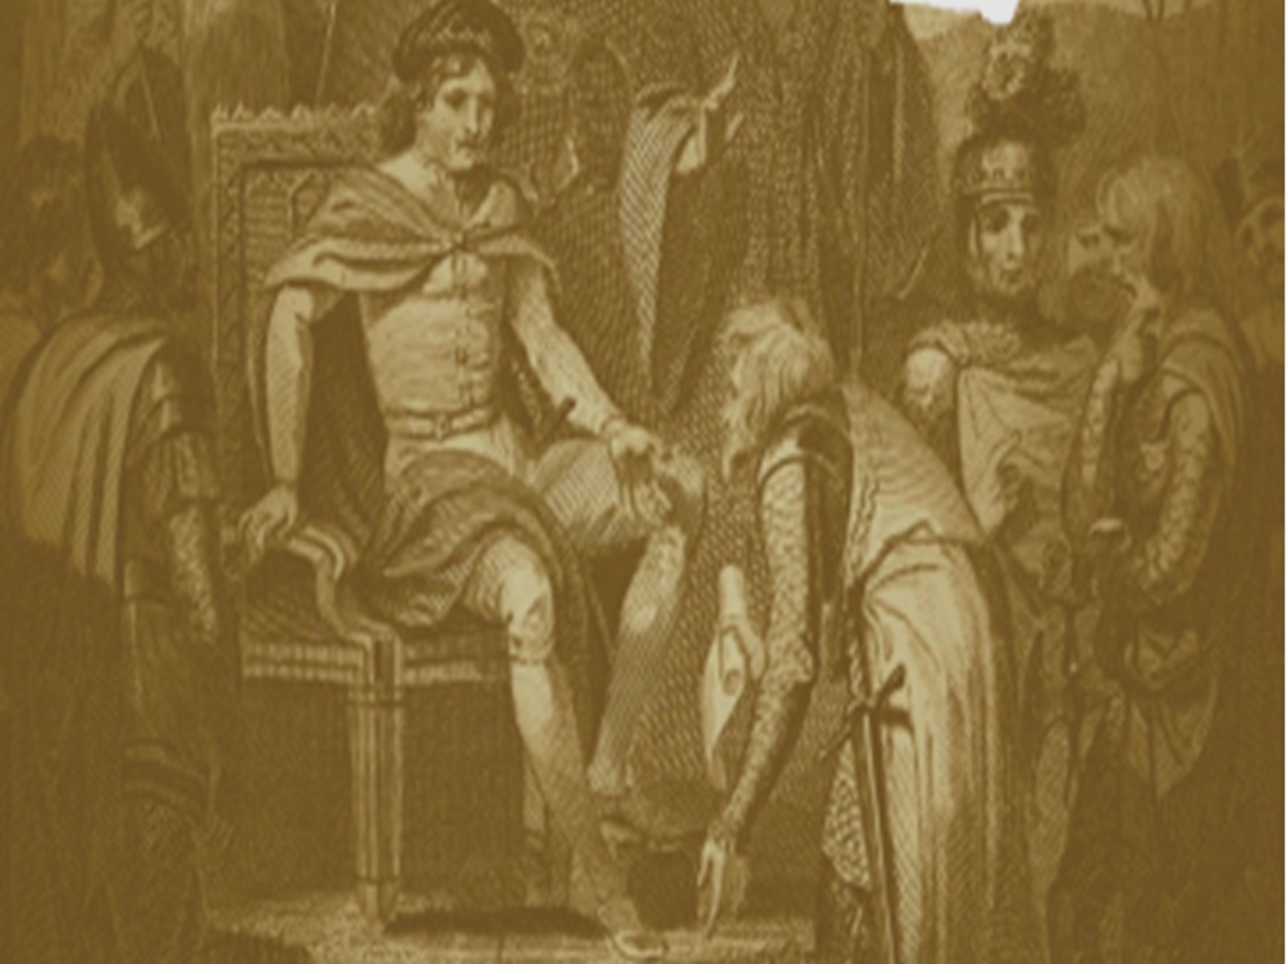
State event on the morning of 15 June 2015 held on the meadow of Runnymede
The Purposes of the Event
To demonstrate that Magna Carta matters as the foundation stone supporting the freedoms enjoyed by millions of people in over 100 countries.
To reaffirm the principles of Rule of Law, fair justice, equality and safety from the abuse of governmental or judicial power.
To promote the vital importance of individual rights and to use the occasion to strengthen human rights globally.
To give thanks to the events of 800 years ago in Runnymede and acknowledge the Great Charter’s impact on constitutional and democratic development ever since.

Slide 21
Magna Carta 800th Anniversary 15 June 2015
The Proposed Outline of the Day
Speeches by the Prime Minister and the Master of the Rolls
Re-dedication of ABA memorial to Magna Carta
Unveiling of a new Surrey County Council art commission
Music and local arts programmes provided by local communities, universities, Temple Church and Parliament Choirs
Up to 4,000 guests to be invited
VIP luncheon courtesy Royal Holloway, University London (RHUL)

Slide 22
Merchandise

Slide 23
£20
£8
£15
£30
www.magnacarta800th.com/shop

Slide 24
£6
www.magnacarta800th.com/shop

Slide 25
Black or Silver (each)
£30
£20
www.magnacarta800th.com/shop

Slide 26
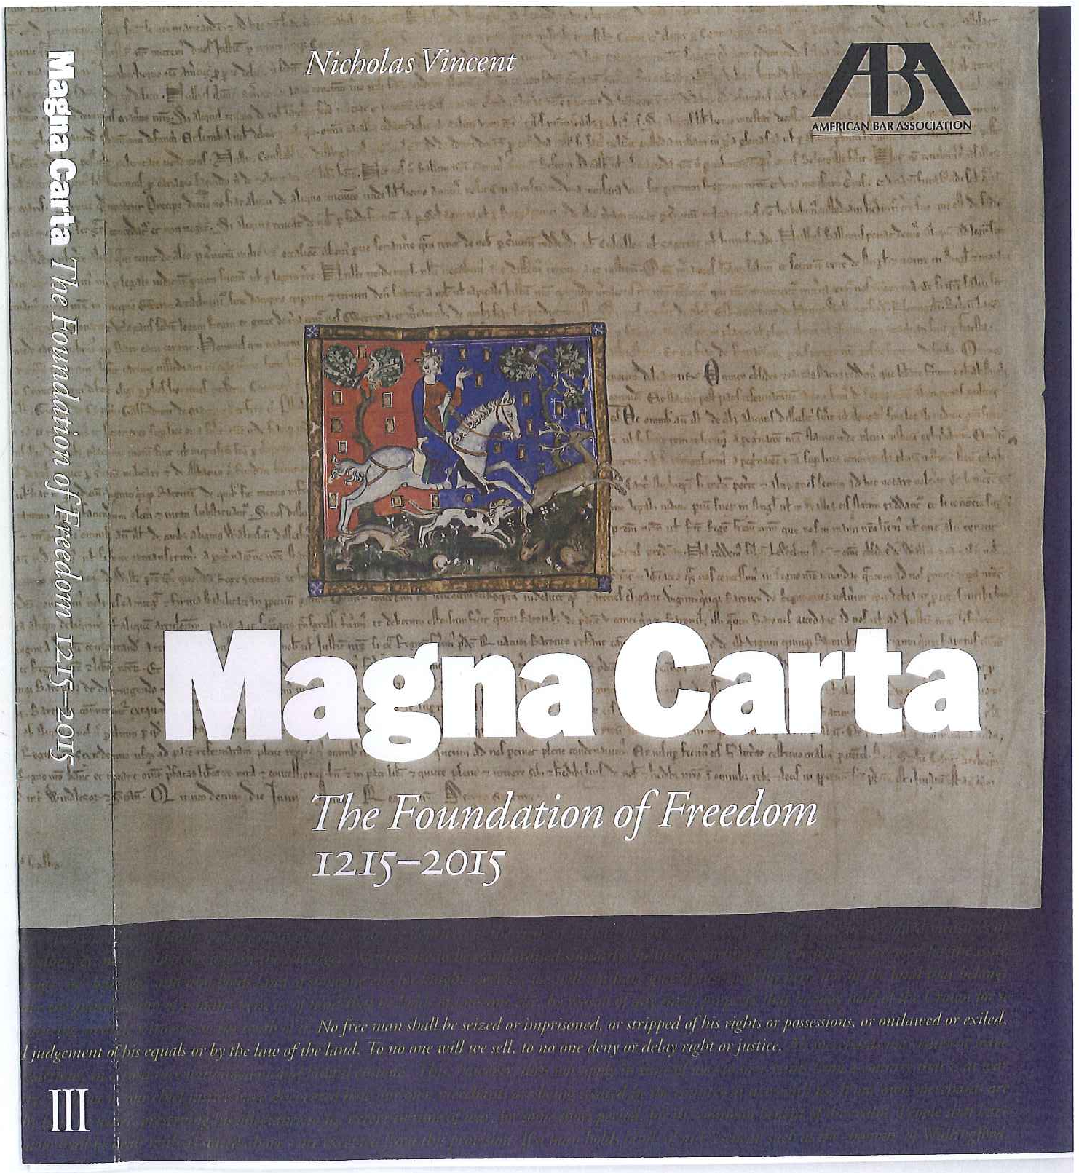
www.magnacarta800th.com/shop
26

Slide 27
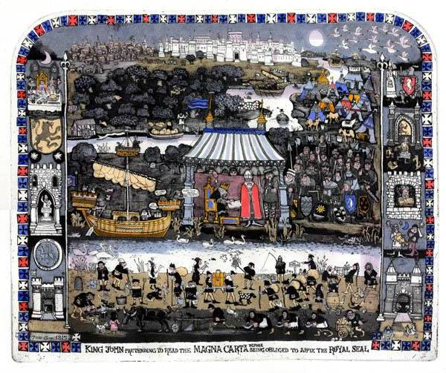
©
www.magnacarta800th.com/shop
~60mm x ~ 52mm @ £600/$1,000
© Graham Clarke

Slide 28
www.magnacarta800th.com
sirrobertworcester@magnacarta800th.com
markgill@magnacarta800th.com

